Slide 1

Nuclear Fusion Technologies
Plasma Magnetic control

Slide 2
Info
Adriano Mele
Campus Riello, blocco F, stanza 1.29
email: adriano.mele@unitus.it

Slide 3
Magnetic control in tokamaks
i.e. the exploitation of dedicated coils to manipulate the magnetic field geometry inside a vacuum chamber filled with (very hot!) plasma
usually divided into a few different sub-problems

Slide 4
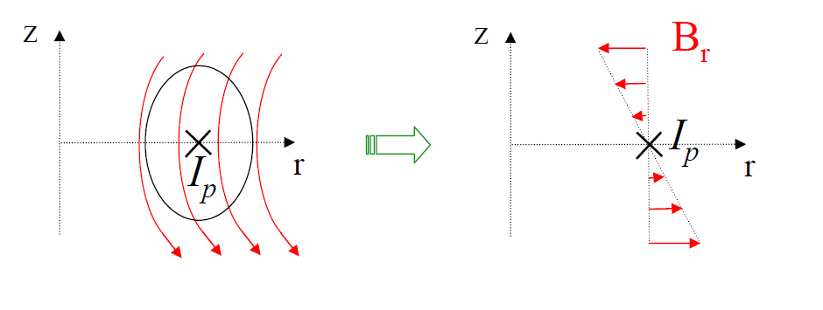
Magnetic control in tokamaks
Vertical stabilization
Elongated plasma configurations are vertically unstable

Slide 5
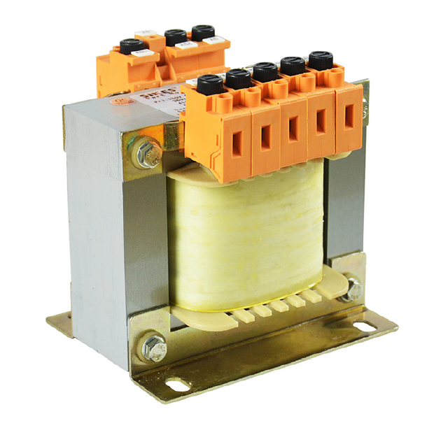
Magnetic control in tokamaks
Plasma current control
Plasma ring as the secondary of a transformer
Ip control compensates for ohmic drop and/or ECD

Slide 6
Magnetic control in tokamaks
Position/shape control
Used to optimize the magnetic configuration (space occupation, confinement performance, plasma-wall clearance, power exhaust…)

Slide 7
Magnetic control in tokamaks
PFC current control
Serves as an actuator by the other control loops

Slide 8
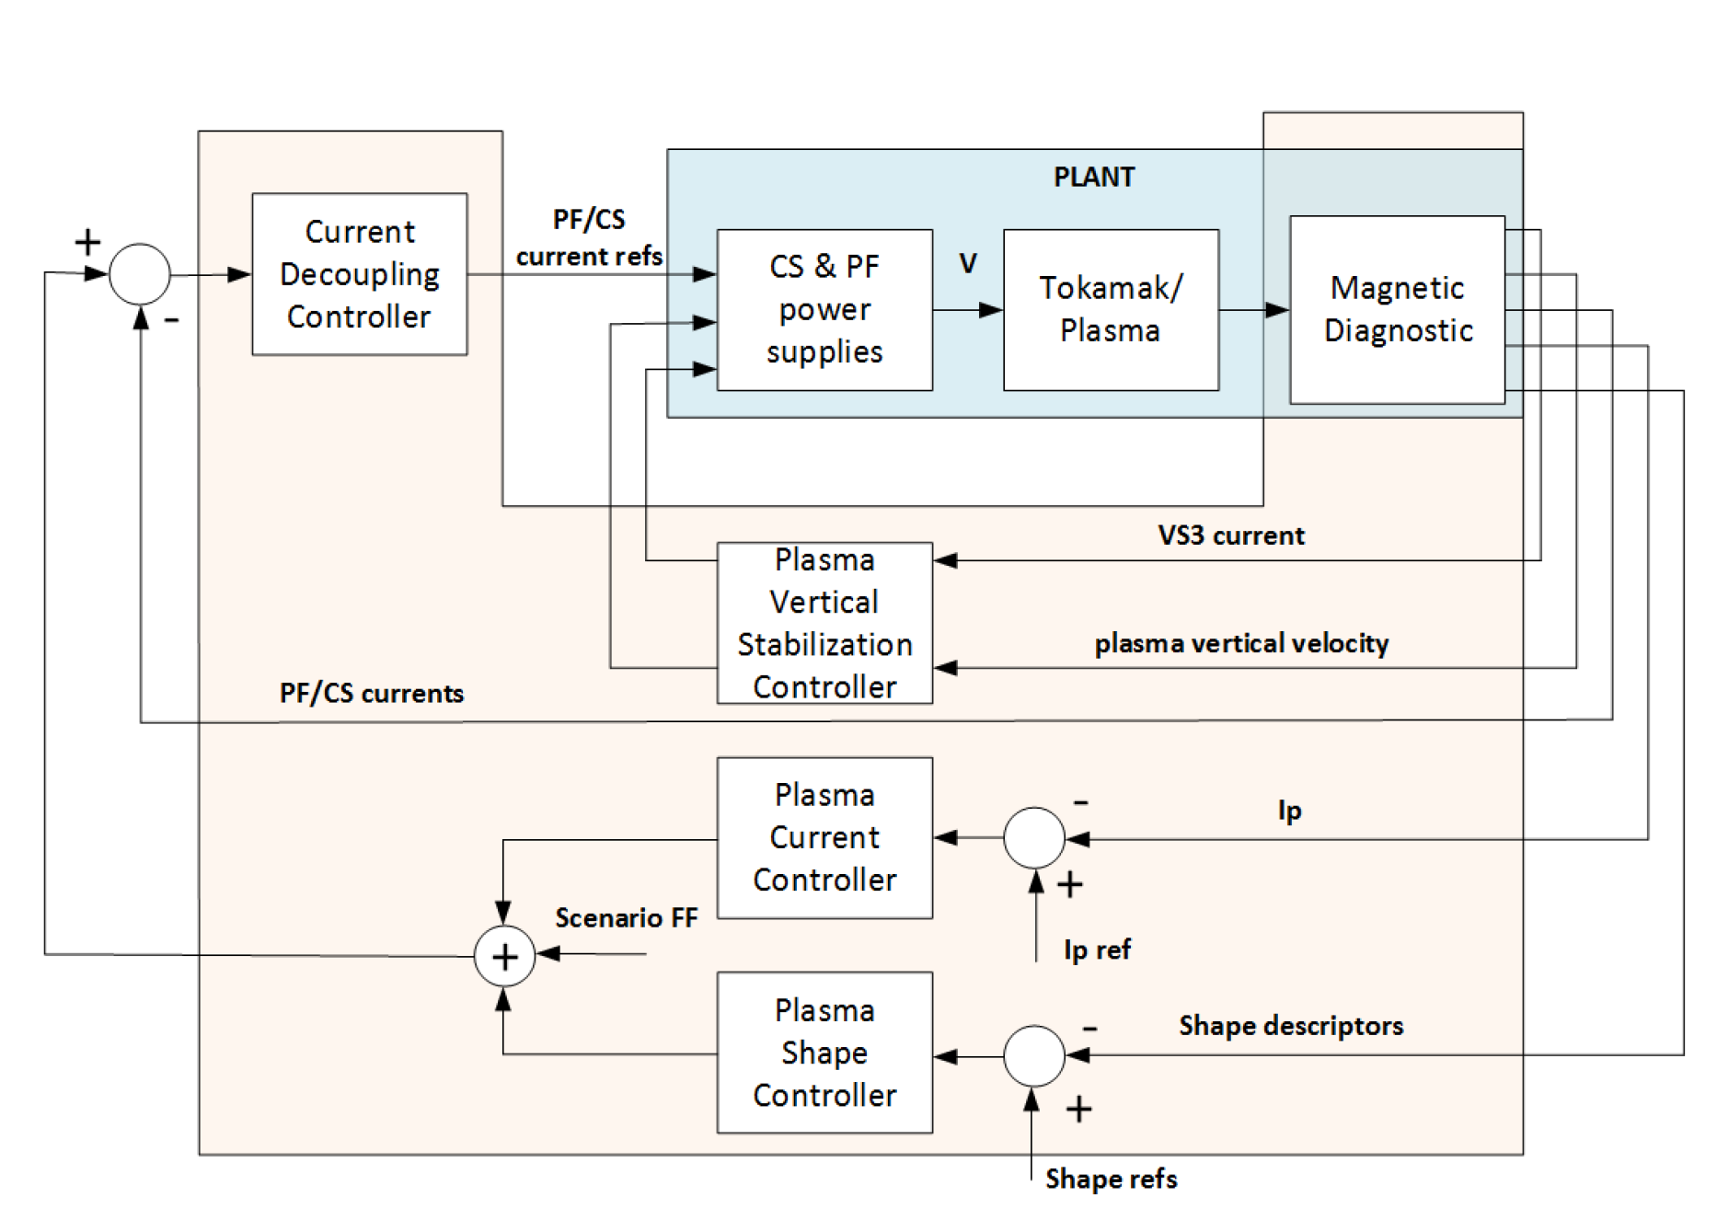
Overall control architecture (example)

Slide 9
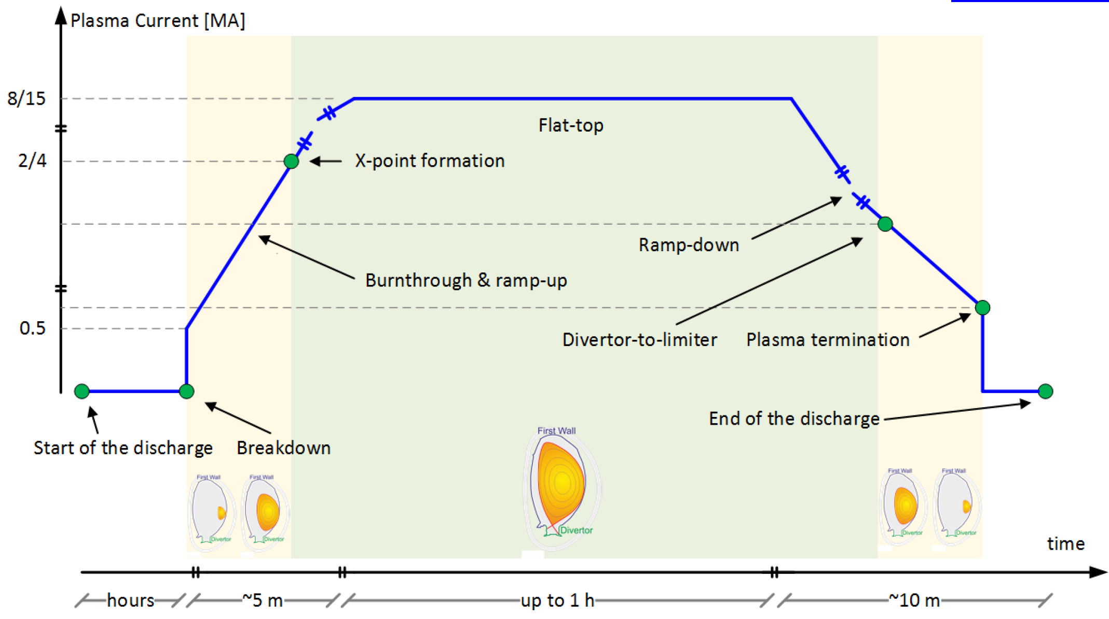
Overall control architecture (example)

Slide 10
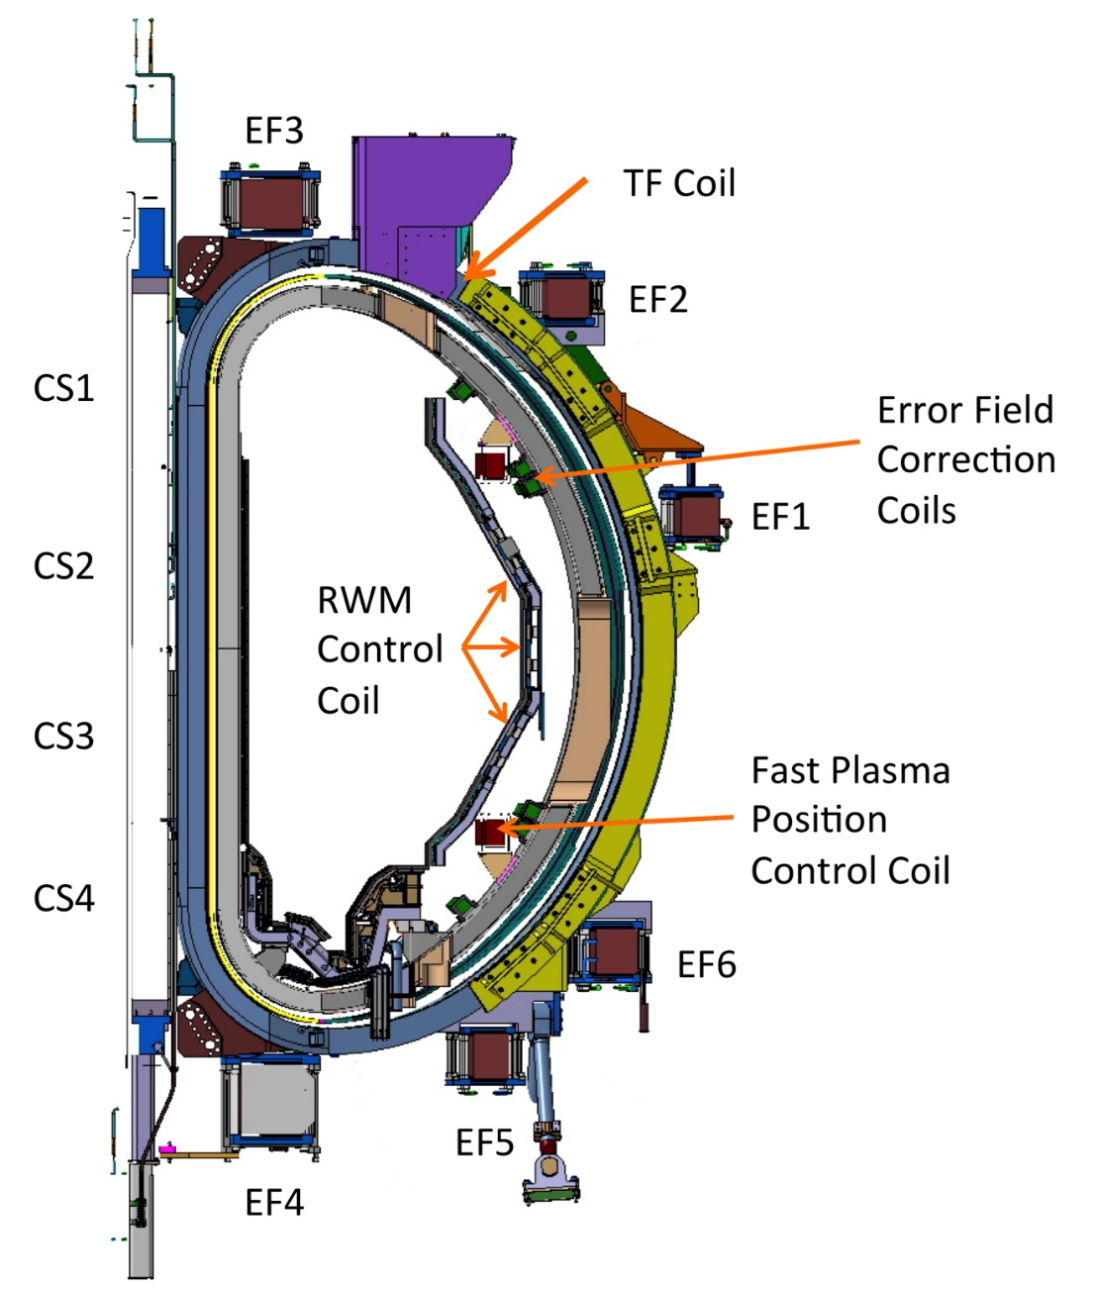
Tokamak magnetic system

Slide 11
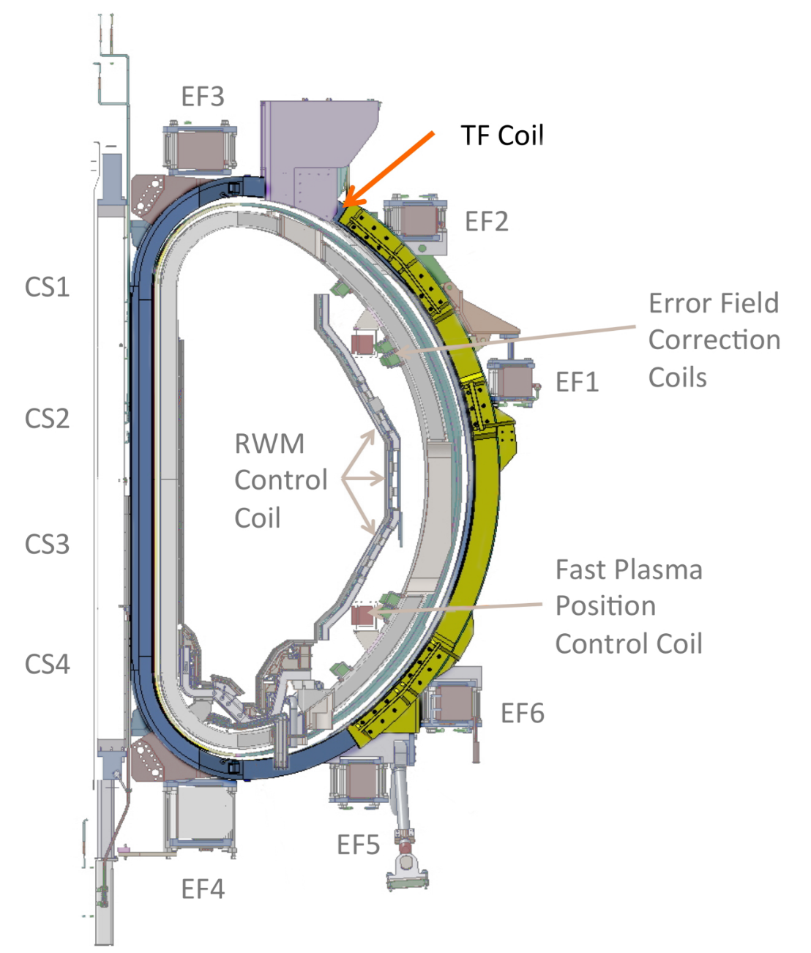
Tokamak magnetic system
Toroidal Field Coils
Provide the strong toroidal field needed for magnetic confinement

Slide 12
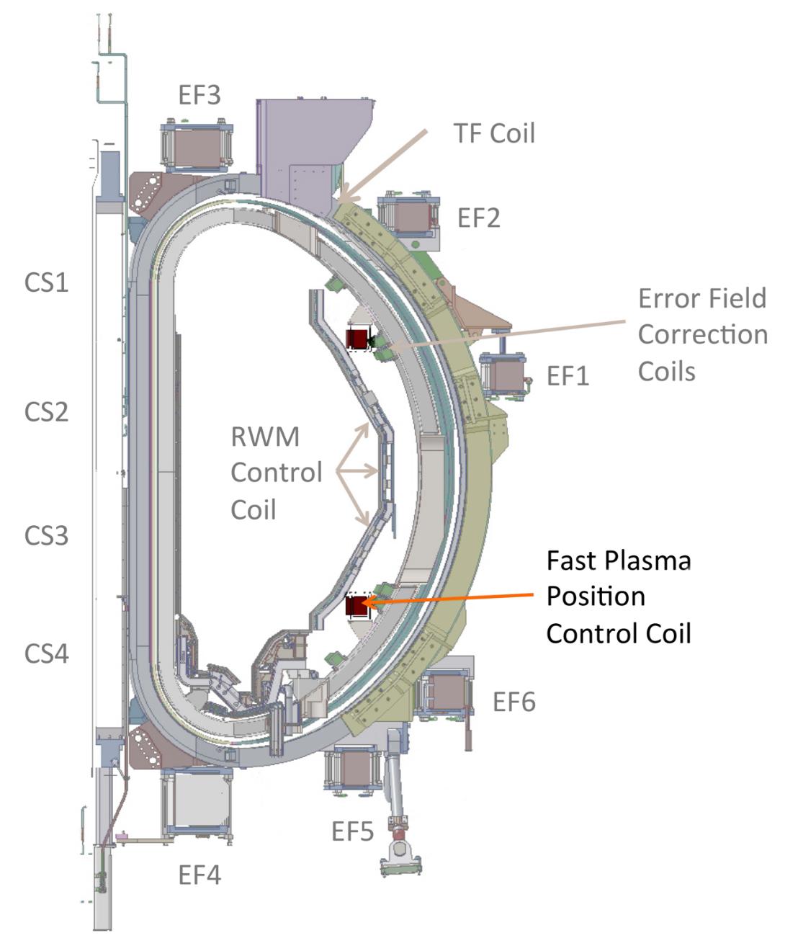
Tokamak magnetic system
In-Vessel Coils
Dedicated to Vertical Stabilization

Slide 13
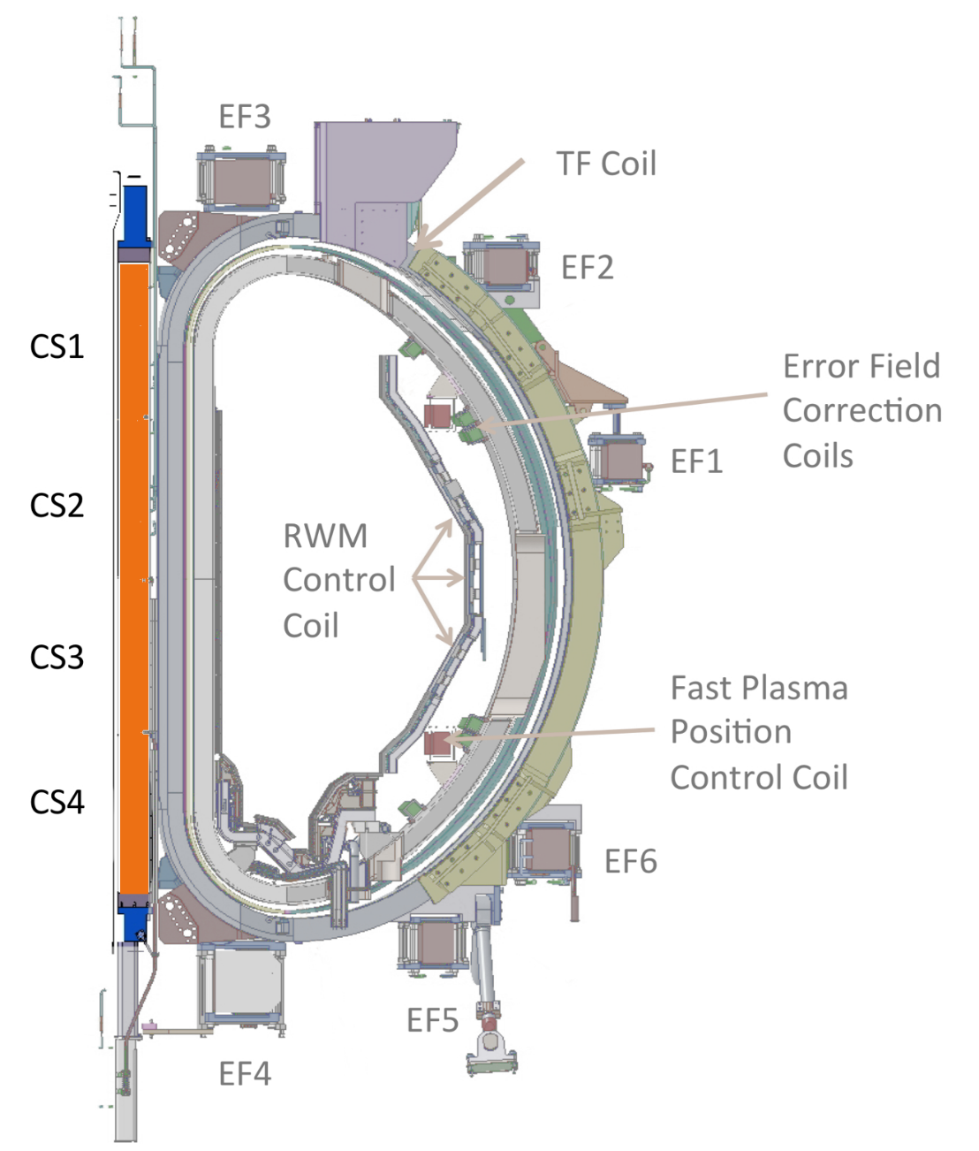
Tokamak magnetic system
Central Solenoid
Mainly for plasma current control
Joint Research Doctorate and European Interuniversity Doctoral Network on fusion Science and Engineering

Slide 14
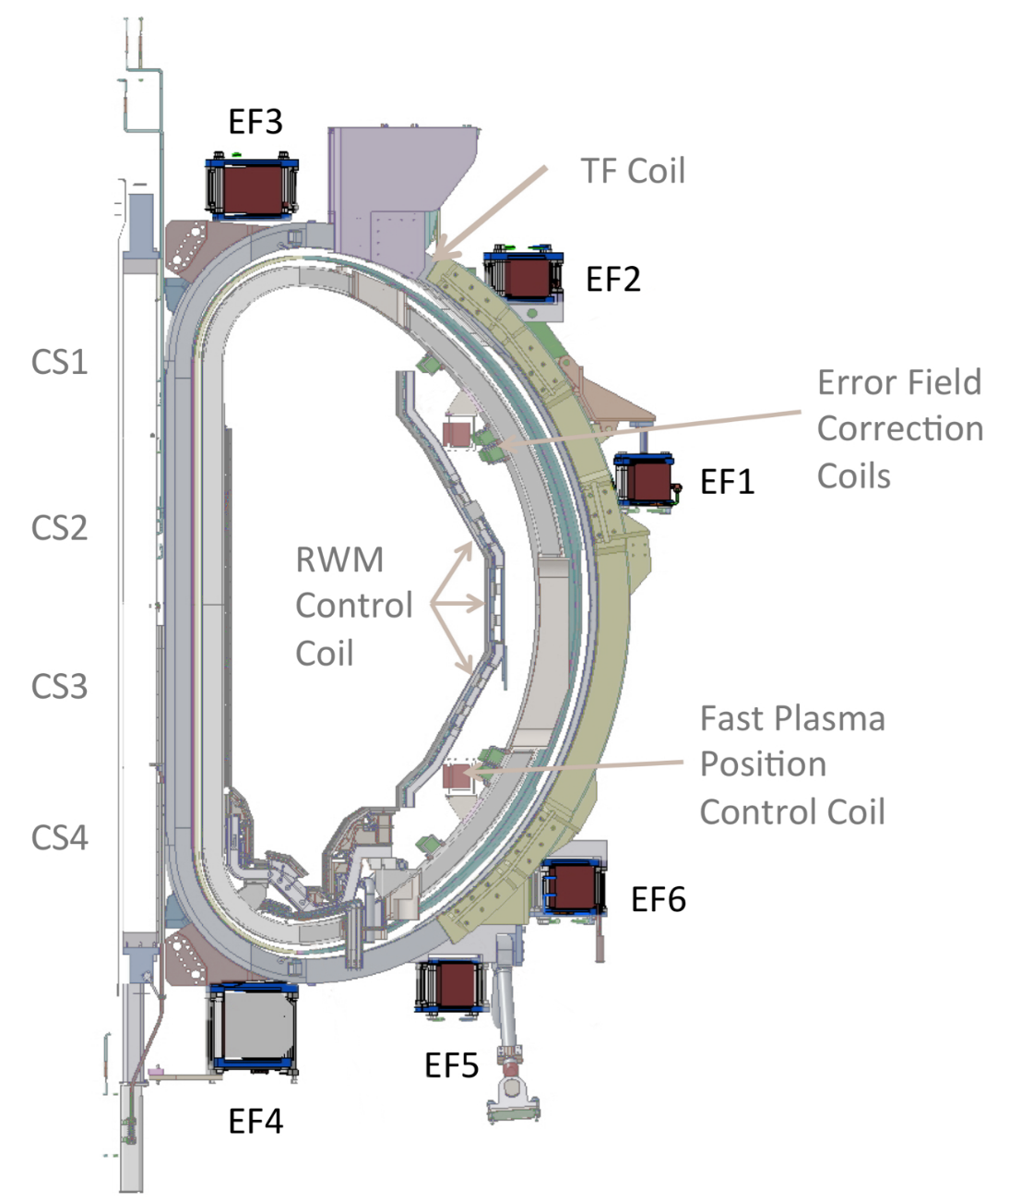
Tokamak magnetic system
Poloidal Field Coils
Mainly for position/shape control
Joint Research Doctorate and European Interuniversity Doctoral Network on fusion Science and Engineering
Notes:
RWM control coils: controllano modi RWM con un certo spettro toroidale (in genere bassa periodicità, ad esempio in JT-60 n=1 (toroidale) m=3 (poloidale)
EFCC: correggono errori di campo locali dovuti a non assialsimmetrie della macchina (ad esempio porte)

Slide 15
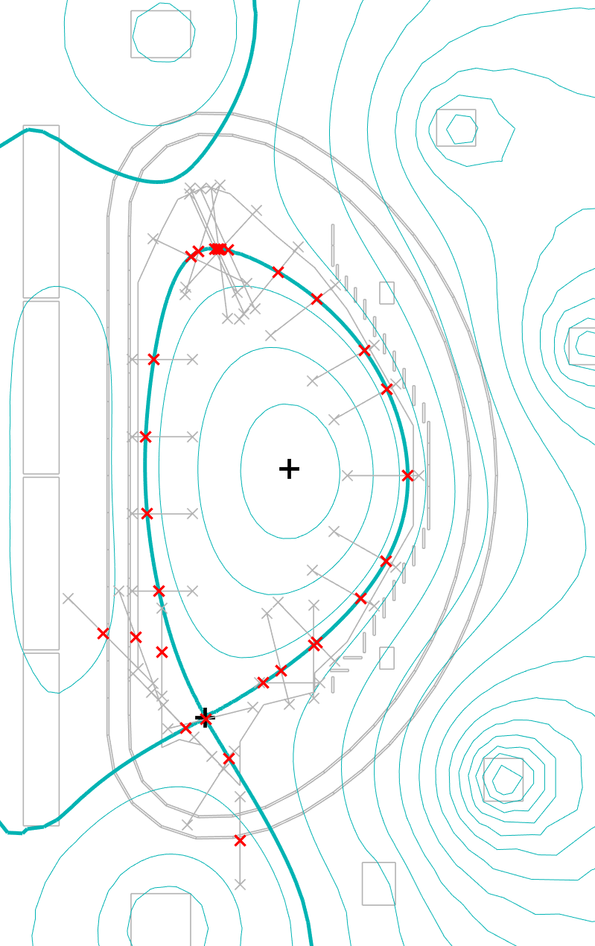
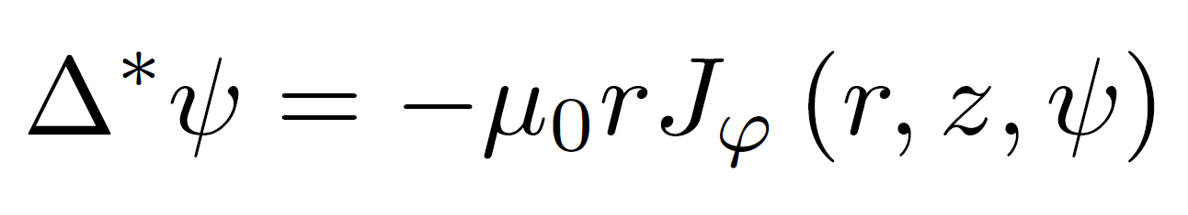
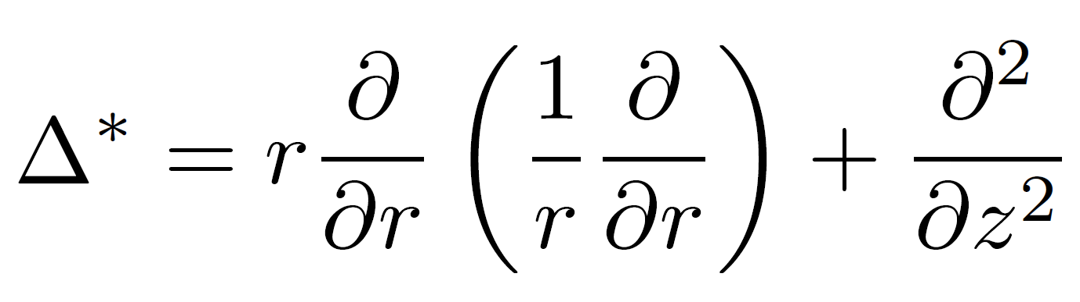
A quick recap: plasma equilibrium
Grad-Shafranov equation describes MHD equilibrium
Notes:
hint to reconstruction codes

Slide 16
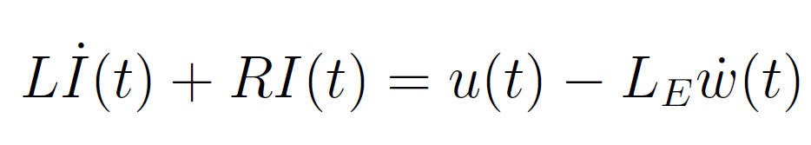
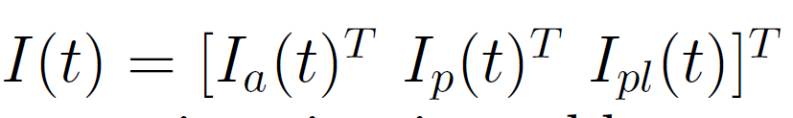
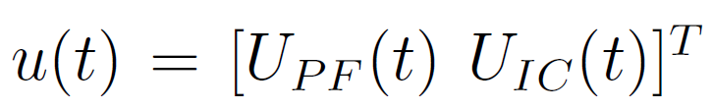
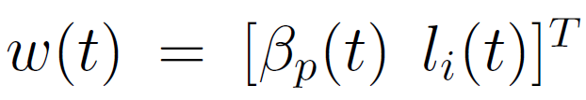
A quick recap: plasma-circuit equations
Plasma-coils coupling is described through a circuit equation
Notes:
For the purpose of shape control, we couple the plasma mhd equilibrium seen before with the circuit equations that take into account the mutual induction between the plasma, the passive structures and the active coils.
The plasma is assumed to evolve quasi-statically through a series of equilibrium states, leaving the electrical dynamics as the dominant one. Once the reference equilibrium has been found (e.g. at a given time instant of a discharge), a linearized model can be computed around this configuration to synthetize the controllers. In our group, this procedure is usually carried out by means of two «in-house» codes called CREATE-L/NL.

Slide 17
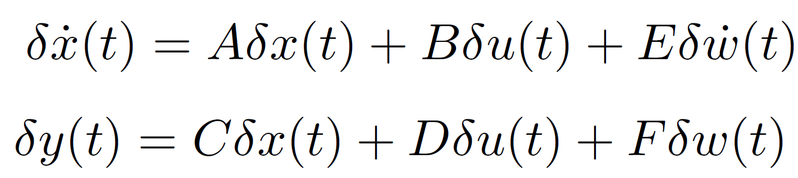
A quick recap: plasma equilibrium
Plasma-circuit linearized equations can be recast in a standard I-S-O form

Slide 18
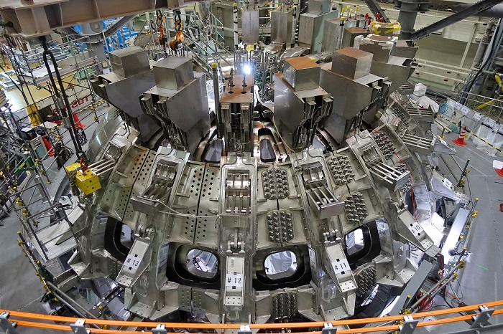
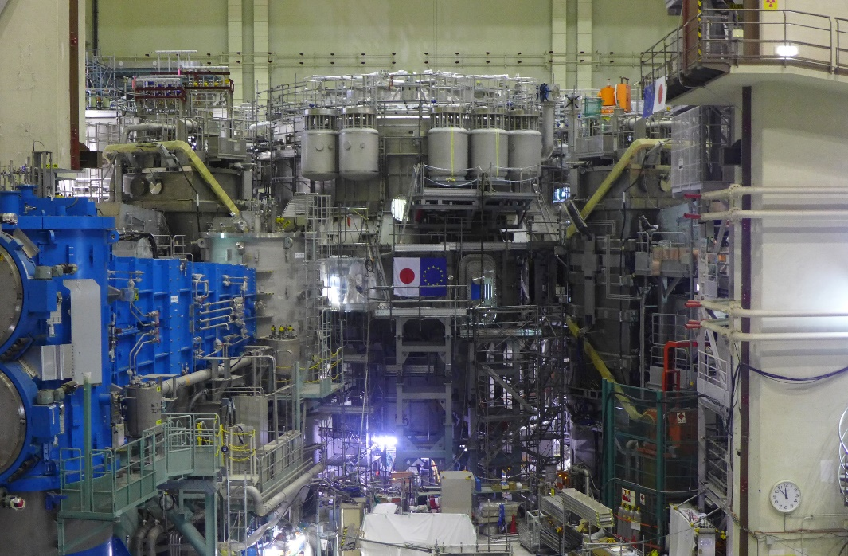
Our playground…
We will see a full design step by step, and we will turn this…

Slide 19
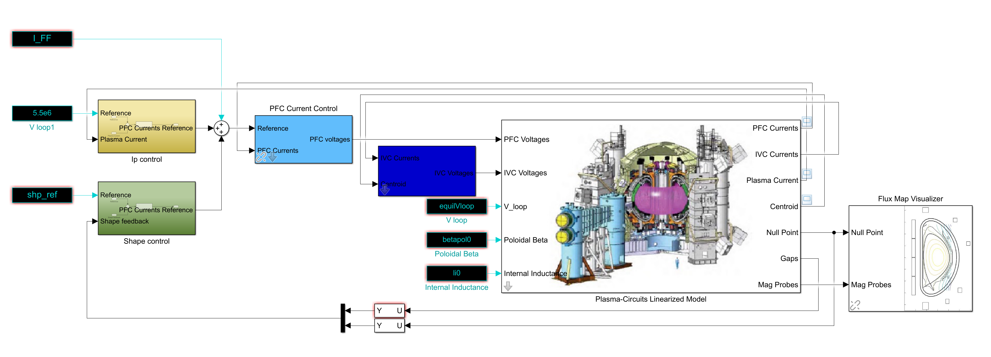
Our playground…
…into (something like) this

Slide 20
A final note
Magnetic control is only one aspect of control in tokamaks. There are other control systems which we’ll not take into account here
kinetic control: plasma temperature/density, q-profile…
«logic»/«industrial» control: plant supervision and coordination, safety systems, controlled shutdown, SCADA/HMIs…
auxiliary systems: gyrotrons, NBIs…
3D control: RWM, NTM suppression through ECRH, …

Slide 21

Questions?

Slide 22

Nuclear Fusion Technologies
a.a. 2022/2023

